Slide 1
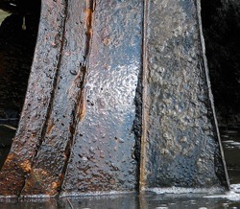
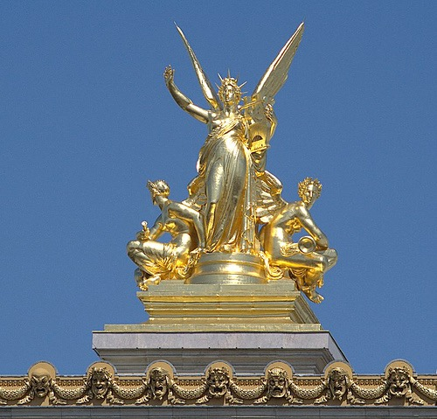

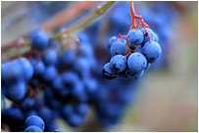
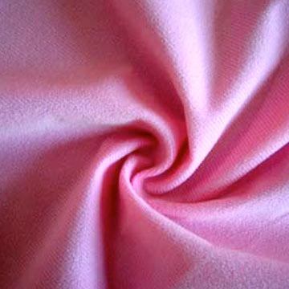

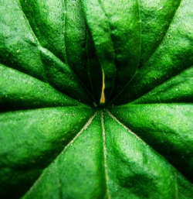

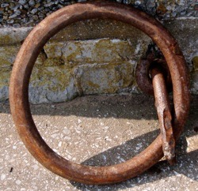
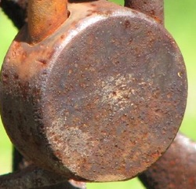
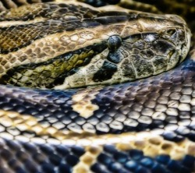
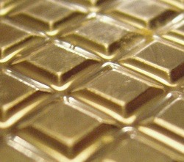
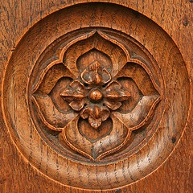
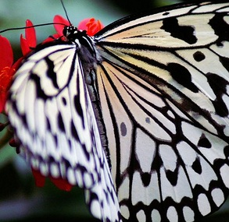
Radiometry and reflectance
Computer Vision
Fall 2019, Lecture 13
http://course.cse.ust.hk/comp4901l

Slide 2
Overview of today’s lecture
Appearance phenomena.
Measuring light and radiometry.
Reflectance and BRDF.
Light sources.

Slide 3
Slide credits
Most of these slides were adapted from:
Srinivasa Narasimhan (16-385, Spring 2014).
Todd Zickler (Harvard University).
Steven Gortler (Harvard University).

Slide 4
Appearance

Slide 5
Appearance
Notes:
The problem becomes especially difficult when we allow ourselves to consider the full diversity of the materials that surround us.
Different materials reflect light in different ways, and while these differences in color, sheen, gloss, haze, and so on are what makes many pictures beautiful, they are also what makes them very hard to analyze radiometrically.

Slide 6

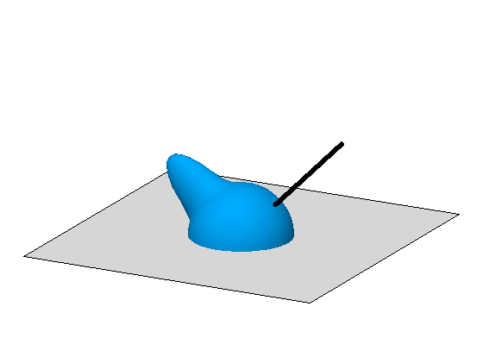

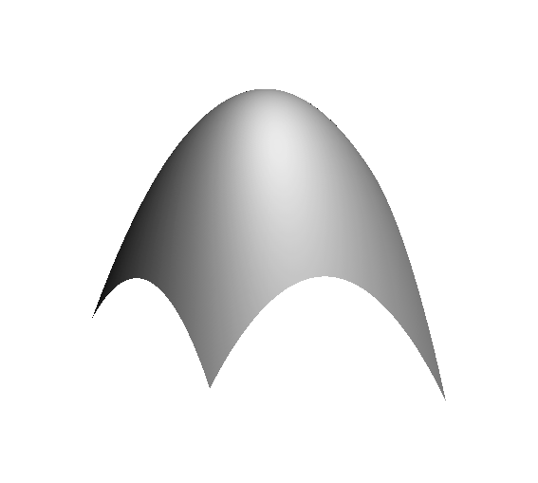
“Physics-based” computer vision
(a.k.a “inverse optics”)
Our challenge: Invent computational representations of shape, lighting, and reflectance that are efficient: simple enough to make inference tractable, yet general enough to capture the world’s most important phenomena
illumination
reflectance
shape
shape
, illumination
, reflectance
Notes:
Our work addresses the problem of inferring scene properties from image data.
Specifically, we want to relate observed image intensities to object shape, scene illumination, and material properties, or surface reflectance.
The task is made difficult by the fact that shape, lighting, and reflectance information are all tightly coupled in the image data so that we cannot typically draw conclusions about one of them without making restrictive assumptions about the others.

Slide 7
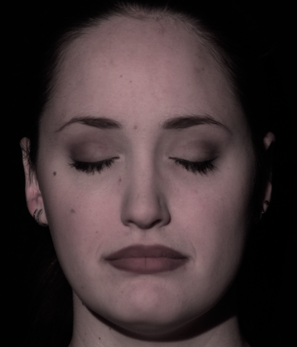
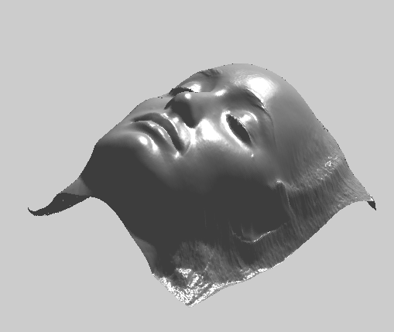
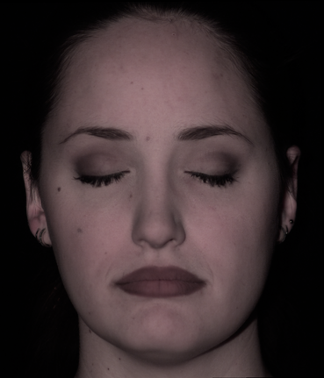
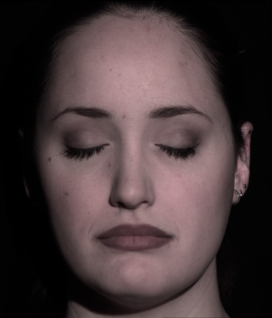
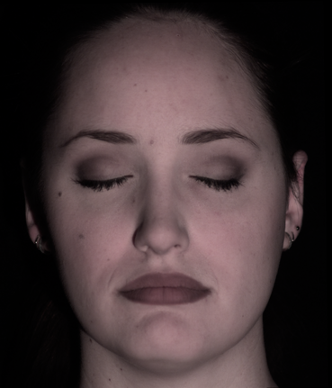
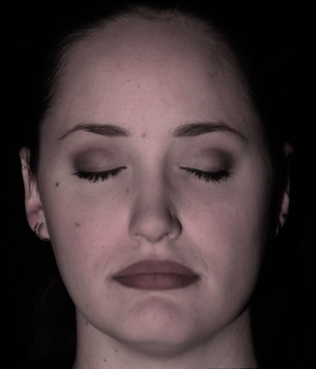
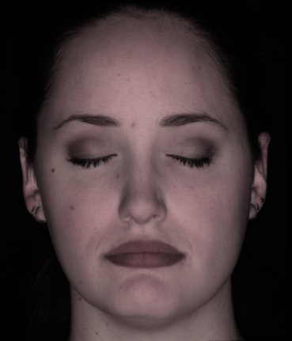
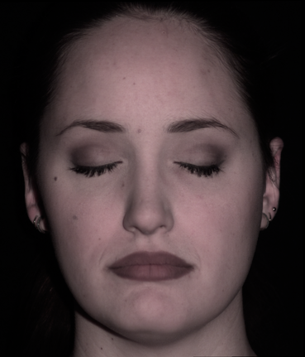
Example application: Photometric Stereo

Slide 8
Why study the physics (optics) of the world? Lets see some pictures!

Slide 9
Light and Shadows

Slide 10
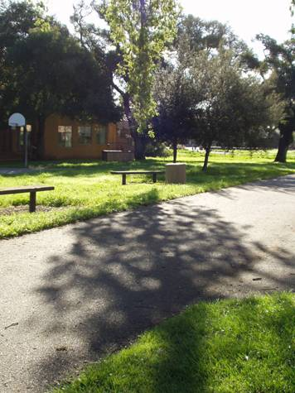

Slide 11
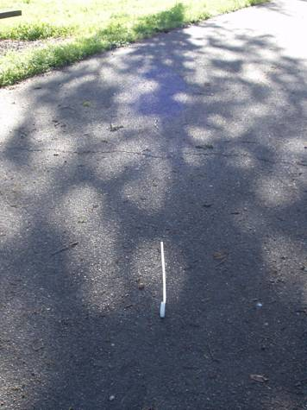
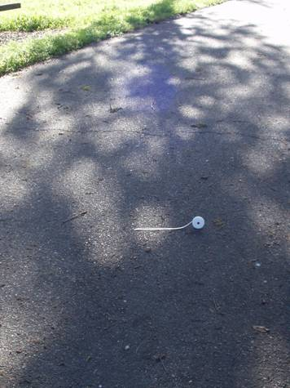

Slide 12
Reflections

Slide 13
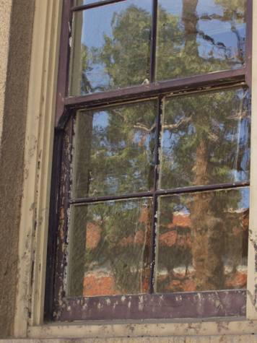
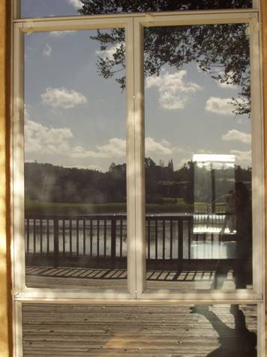

Slide 14
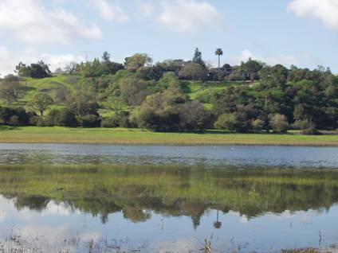

Slide 15
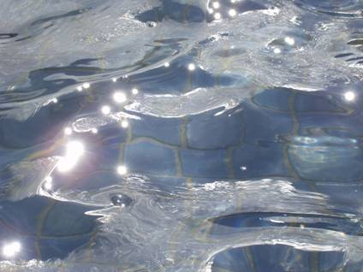
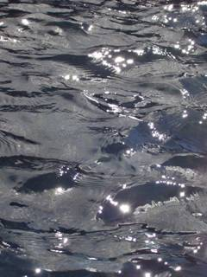

Slide 16
Refractions

Slide 17
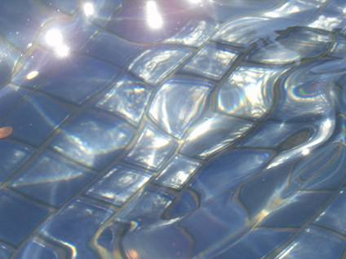

Slide 18
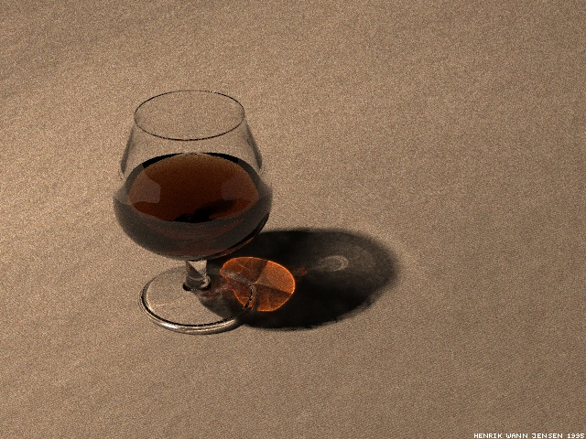
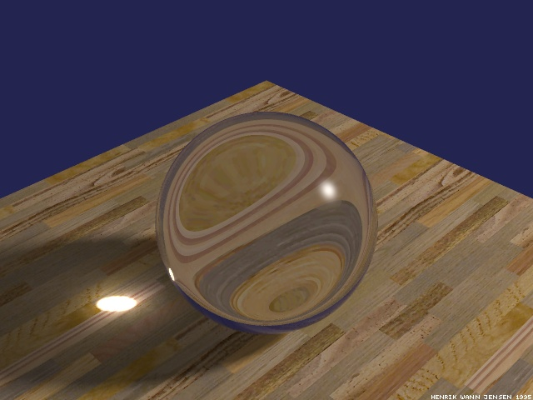

Slide 19
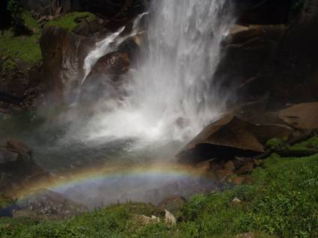

Slide 20
Interreflections

Slide 21
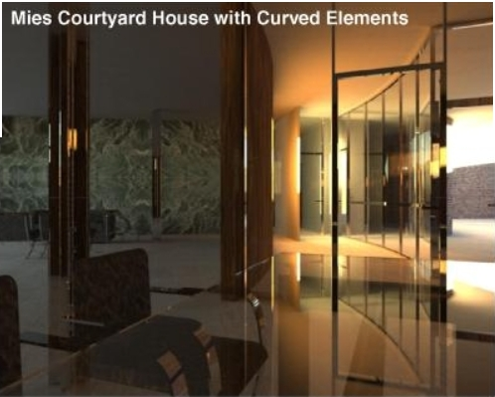

Slide 22
Scattering

Slide 23
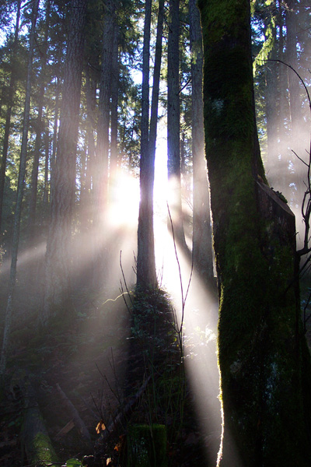
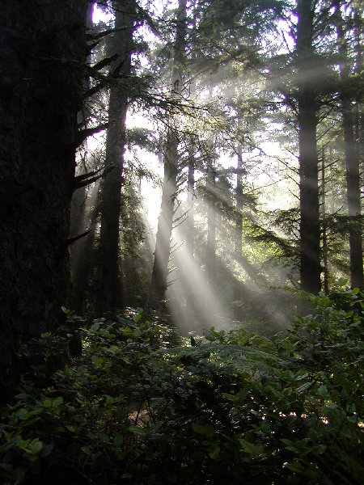

Slide 24
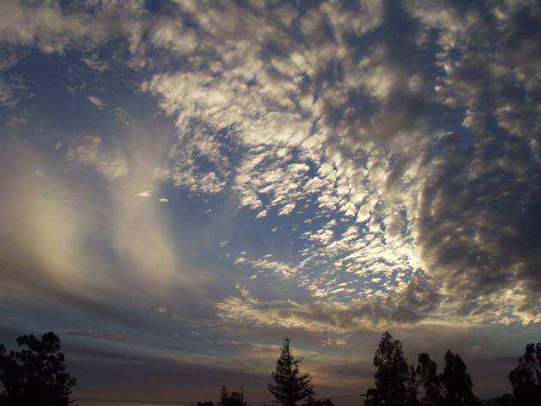

Slide 25
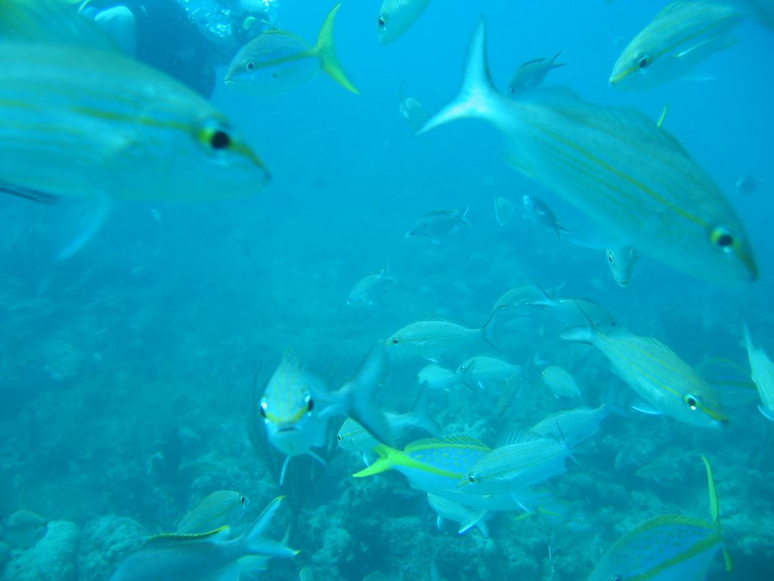

Slide 26
More Complex Appearances

Slide 27

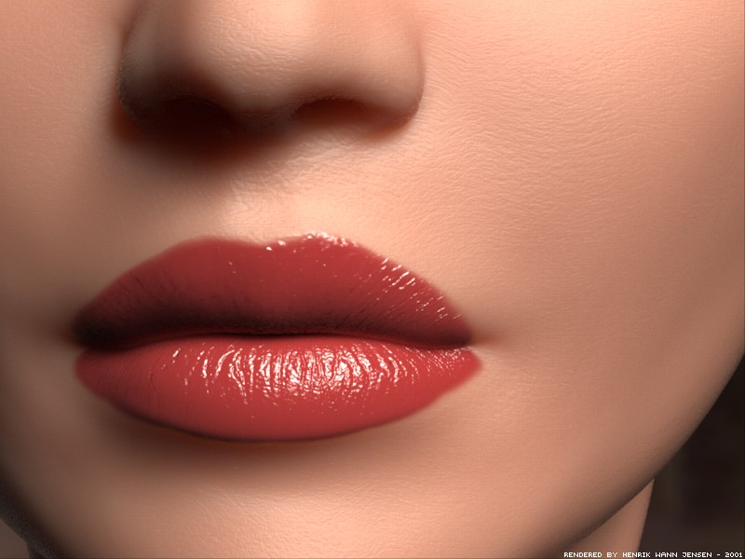

Slide 28
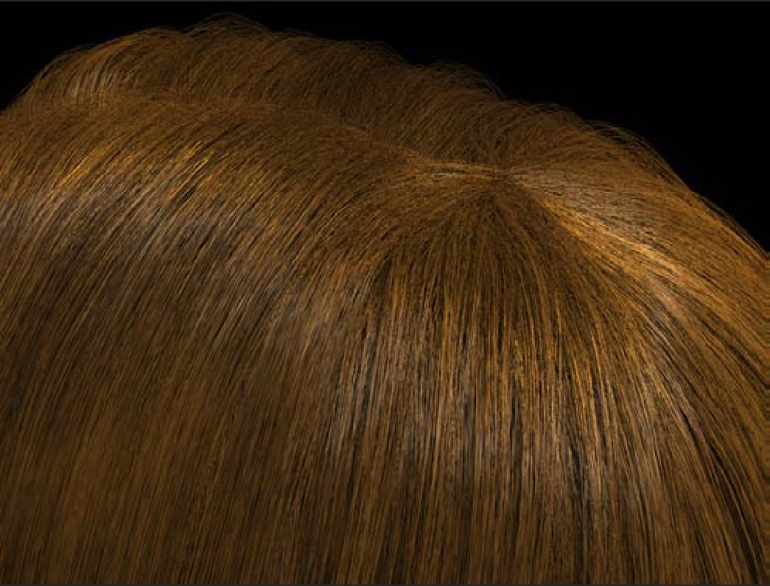

Slide 29
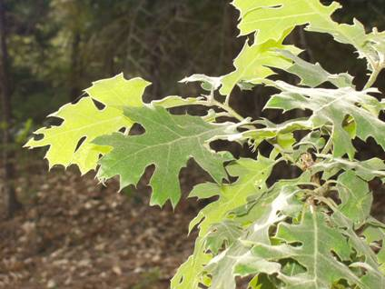
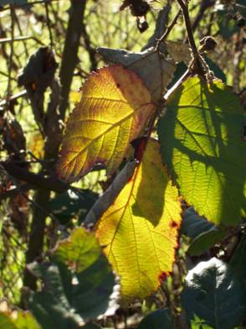
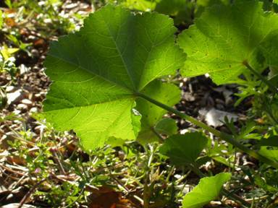

Slide 30
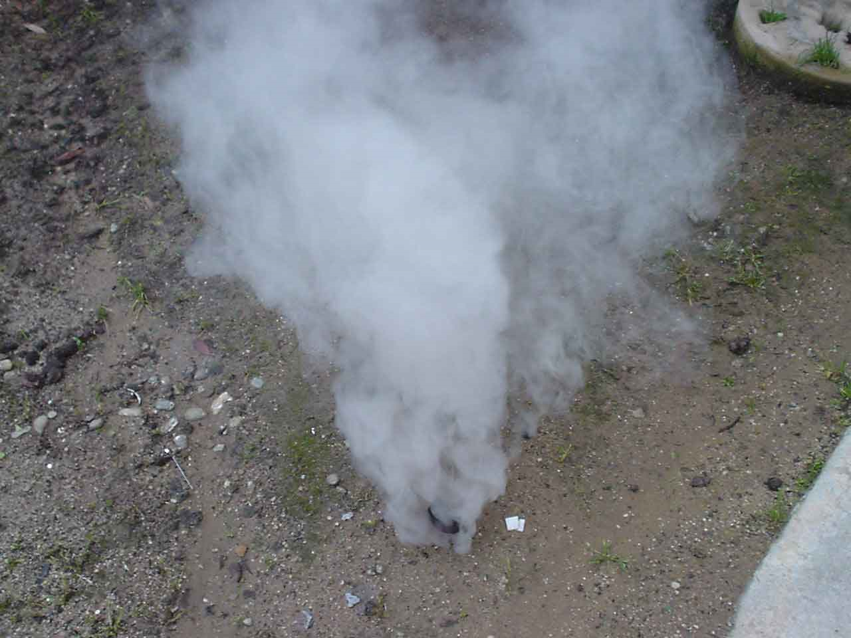

Slide 31
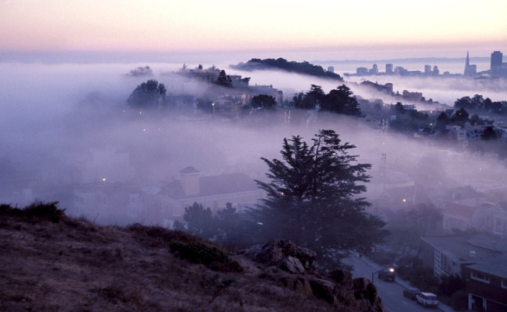
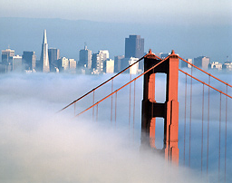
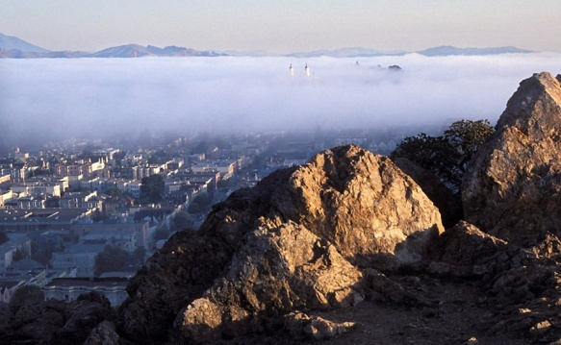
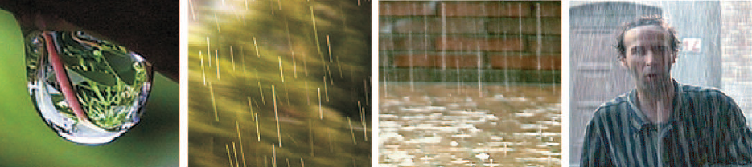
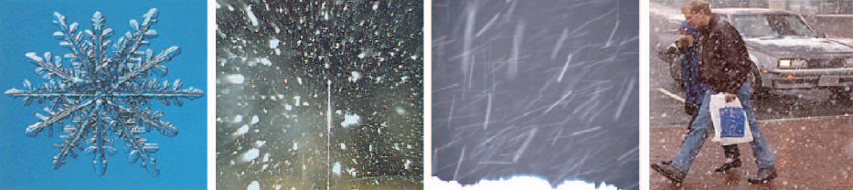

Slide 32
Measuring light and radiometry

Slide 33
Solid angle
The solid angle subtended by a small surface patch with respect to point O is the area of its central projection onto the unit sphere about O
Depends on:
orientation of patch
distance of patch

Slide 34
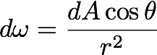
Solid angle
The solid angle subtended by a small surface patch with respect to point O is the area of its central projection onto the unit sphere about O
Depends on:
orientation of patch
distance of patch
One can show:
Units: steradians [sr]

Slide 35
Solid angle
The solid angle subtended by a small surface patch with respect to point O is the area of its central projection onto the unit sphere about O
Depends on:
orientation of patch
distance of patch
One can show:
“surface foreshortening”
Units: steradians [sr]

Slide 36

Solid angle
To calculate solid angle subtended by a surface S relative to O you must add up (integrate) contributions from all tiny patches (nasty integral)
One can show:
“surface foreshortening”
Units: steradians [sr]

Slide 37
Question
Suppose surface S is a hemisphere centered at O. What is the solid angle it subtends?

Slide 38
Question
Suppose surface S is a hemisphere centered at O. What is the solid angle it subtends?
Answer: 2\pi (area of sphere is 4\pi*r^2; area of unit sphere is 4\pi; half of that is 2\pi)

Slide 39

Quantifying light: flux, irradiance, and radiance
Imagine a sensor that counts photons passing through planar patch X in directions within angular wedge W
It measures radiant flux [watts = joules/sec]: rate of photons hitting sensor area
Measurement depends on sensor area |X|
* shown in 2D for clarity; imagine three dimensions
radiant flux

Slide 40

Quantifying light: flux, irradiance, and radiance
Irradiance: A measure of incoming light that is independent of sensor area |X|
Units: watts per square meter [W/m²]

Slide 41

Quantifying light: flux, irradiance, and radiance
Irradiance: A measure of incoming light that is independent of sensor area |X|
Units: watts per square meter [W/m²]

Slide 42

Quantifying light: flux, irradiance, and radiance
Irradiance: A measure of incoming light that is independent of sensor area |X|
Units: watts per square meter [W/m²]
Depends on sensor direction normal.
We keep track of the normal because a planar sensor with distinct orientation would converge to a different limit
In the literature, notations n and W are often omitted, and values are implied by context

Slide 43



Quantifying light: flux, irradiance, and radiance
Radiance: A measure of incoming light that is independent of sensor area |X|, orientation n, and wedge size (solid angle) |W|
Units: watts per steradian per square meter [W/(m²∙sr)]
Has correct units, but still depends on sensor orientation
To correct this, convert to measurement that would have been made if sensor was perpendicular to direction ω

Slide 44

Quantifying light: flux, irradiance, and radiance
Radiance: A measure of incoming light that is independent of sensor area |X|, orientation n, and wedge size (solid angle) |W|
Units: watts per steradian per square meter [W/(m²∙sr)]
“foreshortened area”
Has correct units, but still depends on sensor orientation
To correct this, convert to measurement that would have been made if sensor was perpendicular to direction ω

Slide 45


Quantifying light: flux, irradiance, and radiance
Radiance: A measure of incoming light that is independent of sensor area |X|, orientation n, and wedge size (solid angle) |W|
Units: watts per steradian per square meter [W/(m²∙sr)]
Has correct units, but still depends on sensor orientation
To correct this, convert to measurement that would have been made if sensor was perpendicular to direction ω

Slide 46
Quantifying light: flux, irradiance, and radiance
Radiance: A measure of incoming light that is independent of sensor area |X|, orientation n, and wedge size (solid angle) |W|
Units: watts per steradian per square meter [W/(m²∙sr)]
“foreshortened in the direction of travel”
Has correct units, but still depends on sensor orientation
To correct this, convert to measurement that would have been made if sensor was perpendicular to direction ω

Slide 47
Quantifying light: flux, irradiance, and radiance
Attractive properties of radiance:
Allows computing the radiant flux measured by any finite sensor
Notes:
\Phi(W,X)=\int_X\int_W L(\hat{\boldsymbol{\omega}},x)d\boldsymbol{\omega}dA

Slide 48

Quantifying light: flux, irradiance, and radiance
Attractive properties of radiance:
Allows computing the radiant flux measured by any finite sensor
Notes:
\Phi(W,X)=\int_X\int_W L(\hat{\boldsymbol{\omega}},x)d\boldsymbol{\omega}dA

Slide 49

Quantifying light: flux, irradiance, and radiance
Attractive properties of radiance:
Allows computing the radiant flux measured by any finite sensor
Constant along a ray in free space

Slide 50
Quantifying light: flux, irradiance, and radiance
Attractive properties of radiance:
Allows computing the radiant flux measured by any finite sensor
Constant along a ray in free space
A camera measures radiance (after a one-time radiometric calibration). So RAW pixel values are proportional to radiance.
- “Processed” images (like PNG and JPEG) are not linear radiance measurements!!
Notes:
Possible classroom question: A Lambertian planar light source (e.g., a heated metal sheet) is one whose radiant intensity is J(\omega)=J_o<N,\omega>. Show that emitted radiance is independent of \omega (and thus that the sheet looks equally bright from all directions)

Slide 51


Question
Most light sources, like a heated metal sheet, follow Lambert’s Law
radiant intensity [W/sr]
“Lambertian area source”
What is the radiance of an infinitesimal patch [W/sr･m²]?
Notes:
%%% latexit code
J(\hat{\boldsymbol{\omega}})=J_o\langle\hat{\boldsymbol{\omega}},\hat{\boldsymbol{n}}\rangle=J_o\cos\theta

Slide 52

Question
Most light sources, like a heated metal sheet, follow Lambert’s Law
radiant intensity [W/sr]
“Lambertian area source”
What is the radiance of an infinitesimal patch [W/sr･m²]?
Answer:
(independent of direction)
Notes:
%%% latexit code
J(\hat{\boldsymbol{\omega}})=J_o\langle\hat{\boldsymbol{\omega}},\hat{\boldsymbol{n}}\rangle=J_o\cos\theta

Slide 53
Question
Most light sources, like a heated metal sheet, follow Lambert’s Law
radiant intensity [W/sr]
“Lambertian area source”
What is the radiance of an infinitesimal patch [W/sr･m²]?
Answer:
(independent of direction)
“Looks equally bright when viewed from any direction”
Notes:
%%% latexit code
J(\hat{\boldsymbol{\omega}})=J_o\langle\hat{\boldsymbol{\omega}},\hat{\boldsymbol{n}}\rangle=J_o\cos\theta

Slide 54
Radiometric concepts – boring…but, important!
source
(solid angle subtended by )
(foreshortened area)
(surface area)
(1) Solid Angle :
( steradian )
(4) Surface Radiance (tricky) :
What is the solid angle subtended by a hemisphere?
2
(watts / m steradian )
(2) Radiant Intensity of Source :
( watts / steradian )
Flux emitted per unit foreshortened area
per unit solid angle.
L depends on direction
Surface can radiate into whole hemisphere.
L depends on reflectance properties of surface.
Light Flux (power) emitted per unit solid angle
(3) Surface Irradiance :
( watts / m )
Light Flux (power) incident per unit surface area.
Does not depend on where the light is coming from!

Slide 55
Appearance
Notes:
The problem becomes especially difficult when we allow ourselves to consider the full diversity of the materials that surround us.
Different materials reflect light in different ways, and while these differences in color, sheen, gloss, haze, and so on are what makes many pictures beautiful, they are also what makes them very hard to analyze radiometrically.

Slide 56
“Physics-based” computer vision
(a.k.a “inverse optics”)
illumination
reflectance
shape
shape
, illumination
, reflectance
Notes:
Our work addresses the problem of inferring scene properties from image data.
Specifically, we want to relate observed image intensities to object shape, scene illumination, and material properties, or surface reflectance.
The task is made difficult by the fact that shape, lighting, and reflectance information are all tightly coupled in the image data so that we cannot typically draw conclusions about one of them without making restrictive assumptions about the others.

Slide 57
Reflectance and BRDF

Slide 58
Reflectance
Ratio of outgoing energy to incoming energy at a single point
Want to define a ratio such that it:
converges as we use smaller and smaller incoming and outgoing wedges
does not depend on the size of the wedges (i.e. is intrinsic to the material)
Notes:
f_{x,\hat{\bf n}}(W_\text{in},\hat{\boldsymbol{\omega}}_\text{out})=\frac{L^\text{out}(x,\hat{\boldsymbol{\omega}}_\text{out})}{E_{\hat{\bf n}}^\text{in}(W_\text{in},x)}
\lim_{W_\text{in}\longrightarrow \hat{\boldsymbol{w}}_\text{in}}
f_{x,\hat{\bf n}}(\hat{\boldsymbol{\omega}}_\text{in},\hat{\boldsymbol{\omega}}_\text{out})

Slide 59





Reflectance
Ratio of outgoing energy to incoming energy at a single point
Want to define a ratio such that it:
converges as we use smaller and smaller incoming and outgoing wedges
does not depend on the size of the wedges (i.e. is intrinsic to the material)
Notations x and n often implied by context and omitted; directions \omega are expressed in local coordinate system defined by normal n (and some chosen tangent vector)
Units: sr⁻¹
Called Bidirectional Reflectance Distribution Function (BRDF)
Notes:
f_{x,\hat{\bf n}}(W_\text{in},\hat{\boldsymbol{\omega}}_\text{out})=\frac{L^\text{out}(x,\hat{\boldsymbol{\omega}}_\text{out})}{E_{\hat{\bf n}}^\text{in}(W_\text{in},x)}
\lim_{W_\text{in}\longrightarrow \hat{\boldsymbol{w}}_\text{in}}
f_{x,\hat{\bf n}}(\hat{\boldsymbol{\omega}}_\text{in},\hat{\boldsymbol{\omega}}_\text{out})

Slide 60
BRDF: Bidirectional Reflectance Distribution Function
z
source
incident
direction
viewing
direction
y
normal
surface
element
x
Irradiance at Surface in direction
Radiance of Surface in direction
BRDF :

Slide 61
Reflectance: BRDF
Units: sr⁻¹
Real-valued function defined on the double-hemisphere
Has many useful properties
Notes:
f(\hat{\boldsymbol{\omega}}_\text{in},\hat{\boldsymbol{\omega}}_\text{out})
f(\hat{\boldsymbol{\omega}}_\text{in},\hat{\boldsymbol{\omega}}_\text{out})=f(\hat{\boldsymbol{\omega}}_\text{out},\hat{\boldsymbol{\omega}}_\text{in})
\forall \hat{\boldsymbol{\omega}}_\text{in},\ \ \int_{\Omega_\text{out}} f(\hat{\boldsymbol{\omega}}_\text{in},\hat{\boldsymbol{\omega}}_\text{out})\cos\theta_\text{out}d\hat{\boldsymbol{\omega}}_\text{out}\le 1

Slide 62

Important Properties of BRDFs
z
source
incident
direction
viewing
direction
y
normal
surface
element
x
Conservation of Energy:
Why smaller than or equal?

Slide 63





Property: “Helmholtz reciprocity”
Helmholtz Reciprocity: (follows from 2nd Law of Thermodynamics)
BRDF does not change when source and viewing directions are swapped.
Notes:
For example, a useful property of most opaque materials is that their reflectance function has a symmetry property known as reciprocity.
Reciprocity states that the BRDF is symmetric in terms of its input and output directions, so if we swap these directions, the BRDF value remain unchanged.

Slide 64




Common assumption: Isotropy
BRDF does not change when surface is rotated about the normal.
4D → 3D
[Matusik et al., 2003]
Bi-directional Reflectance Distribution Function (BRDF)
Can be written as a function of 3 variables :
Notes:
An isotropic BRDF is one that is:
- unchanged when the input is spun around the surface normal, and
- symmetric across the incident plane,
These symmetry conditions imply that the domain of an isotropic BRDF is three dimensional instead of four.
<animate> Returning to our problem...

Slide 65

Useful re-parameterization of double-hemisphere
Notes:
An isotropic BRDF is one that is:
- unchanged when the input is spun around the surface normal, and
- symmetric across the incident plane,
These symmetry conditions imply that the domain of an isotropic BRDF is three dimensional instead of four.
<animate> Returning to our problem...

Slide 66

Useful re-parameterization of double-hemisphere
reciprocity
Notes:
An isotropic BRDF is one that is:
- unchanged when the input is spun around the surface normal, and
- symmetric across the incident plane,
These symmetry conditions imply that the domain of an isotropic BRDF is three dimensional instead of four.
<animate> Returning to our problem...

Slide 67
Useful re-parameterization of double-hemisphere
reciprocity
isotropy:
Notes:
An isotropic BRDF is one that is:
- unchanged when the input is spun around the surface normal, and
- symmetric across the incident plane,
These symmetry conditions imply that the domain of an isotropic BRDF is three dimensional instead of four.
<animate> Returning to our problem...

Slide 68

Reflectance: BRDF
Units: sr⁻¹
Real-valued function defined on the double-hemisphere
Has many useful properties
Allows computing output radiance (and thus pixel value) for any configuration of lights and viewpoint
reflectance equation
Why is there a cosine in the reflectance equation?
Notes:
f(\hat{\boldsymbol{\omega}}_\text{in},\hat{\boldsymbol{\omega}}_\text{out})
f(\hat{\boldsymbol{\omega}}_\text{in},\hat{\boldsymbol{\omega}}_\text{out})=f(\hat{\boldsymbol{\omega}}_\text{out},\hat{\boldsymbol{\omega}}_\text{in})
\forall \hat{\boldsymbol{\omega}}_\text{in},\ \ \int_{\Omega_\text{out}} f(\hat{\boldsymbol{\omega}}_\text{in},\hat{\boldsymbol{\omega}}_\text{out})\cos\theta_\text{out}d\hat{\boldsymbol{\omega}}_\text{out}\le 1

Slide 69

Derivation of the Reflectance Equation
From the definition of BRDF:

Slide 70
Derivation of the Scene Radiance Equation
From the definition of BRDF:
Write Surface Irradiance in terms of Source Radiance:
Integrate over entire hemisphere of possible source directions:
Convert from solid angle to theta-phi representation:

Slide 71


Slide 72
BRDF
Bi-directional Reflectance Distribution Function (BRDF)

Slide 73


BRDF
Lambertian (diffuse) BRDF: energy equally distributed in all directions
What does the BRDF equal in this case?
Bi-directional Reflectance Distribution Function (BRDF)
Notes:
At the other end, as I already mentioned is something that is ideally diffuse.

Slide 74
Diffuse Reflection and Lambertian BRDF
source intensity I
incident
direction
normal
viewing
direction
surface
element
Surface appears equally bright from ALL directions! (independent of )
albedo
Lambertian BRDF is simply a constant :
Most commonly used BRDF in Vision and Graphics!

Slide 75


BRDF
Specular BRDF: all energy concentrated in mirror direction
What does the BRDF equal in this case?
Bi-directional Reflectance Distribution Function (BRDF)
Notes:
In the limit, something that is a perfect mirror reflects light in only one direction and the reflectance is a delta function.

Slide 76
Specular Reflection and Mirror BRDF
source intensity I
specular/mirror
direction
incident
direction
normal
viewing
direction
surface
element
Valid for very smooth surfaces.
All incident light energy reflected in a SINGLE direction (only when = ).
Mirror BRDF is simply a double-delta function :
specular albedo

Slide 77





Example Surfaces
Body Reflection:
Diffuse Reflection
Matte Appearance
Non-Homogeneous Medium
Clay, paper, etc
Surface Reflection:
Specular Reflection
Glossy Appearance
Highlights
Dominant for Metals
Many materials exhibit
both Reflections:

Slide 78

BRDF
Glossy BRDF: more energy concentrated in mirror direction than elsewhere
Bi-directional Reflectance Distribution Function (BRDF)
Notes:
something that is more glossy will have a substantially different reflectance function -- one in which more of the energy is concentrated in the mirror direction

Slide 79
Trick for dielectrics (non-metals)
BRDF is a sum of a Lambertian diffuse component and non-Lambertian specular components
The two components differ in terms of color and polarization, and under certain conditions, this can be exploited to separate them.
Notes:
Before we continue, I want to clarify what I mean by separability, or the idea that SV-BRDF can be separated into distinct diffuse and specular components.

Slide 80

Trick for dielectrics (non-metals)
BRDF is a sum of a Lambertian diffuse component and non-Lambertian specular components
The two components differ in terms of color and polarization, and under certain conditions, this can be exploited to separate them.
Often called the dichromatic BRDF:
Diffuse term varies with wavelength, constant with polarization
Specular term constant with wavelength, varies with polarization
Notes:
Before we continue, I want to clarify what I mean by separability, or the idea that SV-BRDF can be separated into distinct diffuse and specular components.

Slide 81




Trick for dielectrics (non-metals)
DIFFUSE
SPECULAR
=
+
In this example, the two components were separated using linear polarizing filters on the camera and light source.

Slide 82



Trick for dielectrics (non-metals)
DIFFUSE
SPECULAR
=
+

Slide 83



Tabulated 4D BRDFs (hard to measure)
Gonioreflectometer
[Ngan et al., 2005]
Notes:
At the other end, as I already mentioned is something that is ideally diffuse.

Slide 84




Low-parameter (non-linear) BRDF models
A small number of parameters define the (2D,3D, or 4D) function
Except for Lambertian, the BRDF is non-linear in these parameters
Examples:
Where do these constants come from?
Lambertian:
Phong:
Blinn:
Lafortune:
Ward:
α is called the albedo

Slide 85
Reflectance Models
Reflection: An Electromagnetic Phenomenon
Two approaches to derive Reflectance Models:
Physical Optics (Wave Optics)
Geometrical Optics (Ray Optics)
Geometrical models are approximations to physical models
But they are easier to use!

Slide 86


Reflectance that Require Wave Optics

Slide 87
Summary of some useful lighting models
plenoptic function (function on 5D domain)
far-field illumination (function on 2D domain)
low-frequency far-field illumination (nine numbers)
directional lighting (three numbers = direction and strength)
point source (four numbers = location and strength)

Slide 88
Light sources

Slide 89
“Physics-based” computer vision
(a.k.a “inverse optics”)
illumination
reflectance
shape
shape
, illumination
, reflectance
Notes:
Our work addresses the problem of inferring scene properties from image data.
Specifically, we want to relate observed image intensities to object shape, scene illumination, and material properties, or surface reflectance.
The task is made difficult by the fact that shape, lighting, and reflectance information are all tightly coupled in the image data so that we cannot typically draw conclusions about one of them without making restrictive assumptions about the others.

Slide 90



Lighting models: Plenoptic function
Radiance as a function of position and direction
Radiance as a function of position, direction, and time
Spectral radiance as a function of position, direction, time and wavelength
[Adelson and Bergen, 1991]

Slide 91


Lighting models: far-field (or directional) approximation
Assume that, over the observed region of interest, all source of incoming flux are relatively far away
radiance only depends on direction; not location
ignores close
inter-reflections
[Debevec, 1998]

Slide 92




Application: augmented reality
[Debevec, 1998]

Slide 93



Application: augmented reality
[Debevec, 1998]

Slide 94

Application: augmented reality
http://gl.ict.usc.edu/LightStages/

Slide 95


Application: augmented reality
[https://developer.apple.com/arkit/]
[https://developers.google.com/ar/]

Slide 96


Lighting models: far-field approximation
One can download far-field lighting environments that have been captured by others
A number of apps and software exist to help you capture capture your own environments using a light probe
[http://gl.ict.usc.edu/Data/HighResProbes/]

Slide 97

Application: inferring outdoor illumination
[Lalonde et al., 2009]

Slide 98

A further simplification:
Low-frequency illumination
First nine basis functions are sufficient for re-creating Lambertian appearance
[Ramamoorthi and Hanrahan, 2001; Basri and Jacobs, 2003]

Slide 99


Low-frequency illumination
[Ramamoorthi and Hanrahan, 2001; Basri and Jacobs, 2003]

Slide 100

Low-frequency illumination
Truncate to first 9 terms
[Ramamoorthi and Hanrahan, 2001; Basri and Jacobs, 2003]

Slide 101




Application: Trivial rendering
Capture light probe
Rendering a (convex) diffuse object in this environment simply requires a lookup based on the surface normal at each pixel
Low-pass filter (truncate to first nine SHs)

Slide 102



White-out: Snow and Overcast Skies
CAN’T perceive the shape of the snow covered terrain!
CAN perceive shape in regions
lit by the street lamp!!
WHY?

Slide 103
Diffuse Reflection from Uniform Sky
Assume Lambertian Surface with Albedo = 1 (no absorption)
Assume Sky radiance is constant
Substituting in above Equation:
Radiance of any patch is the same as Sky radiance !! (white-out condition)

Slide 104




Even simpler:
Directional lighting
Assume that, over the observed region of interest, all source of incoming flux is from one direction
Convenient representation
“light direction”
“light strength”
Notes:
& L(x,\omega,t,\lambda)\longrightarrow L(x,t,\lambda)\longrightarrow s(t,\lambda)\delta(\omega=\omega_o(t))\\
& L(x,\omega)\longrightarrow L(\omega)\longrightarrow s\delta(\omega=\omega_o)
\vec{\boldsymbol{\ell}}=(\ell_x,\ell_y,\ell_z)
\hat{\boldsymbol{\ell}}=\frac{\vec{\boldsymbol{\ell}}}{||\vec{\boldsymbol{\ell}}||}

Slide 105

Simple shading
ASSUMPTION 1:
LAMBERTIAN
ASSUMPTION 2:
DIRECTIONAL LIGHTING
Notes:
I=a\hat{\bf n}^\top\vec{\boldsymbol{\ell}}

Slide 106
“N-dot-l” shading
ASSUMPTION 1:
LAMBERTIAN
ASSUMPTION 2:
DIRECTIONAL LIGHTING
Notes:
I=a\hat{\bf n}^\top\vec{\boldsymbol{\ell}}

Slide 107

An ideal point light source
Think of this as a spatially-varying directional source where
the direction is away from x_o
the strength is proportional to 1/(distance)^2

Slide 108
Summary of some useful lighting models
plenoptic function (function on 5D domain)
far-field illumination (function on 2D domain)
low-frequency far-field illumination (nine numbers)
directional lighting (three numbers = direction and strength)
point source (four numbers = location and strength)

Slide 109
References
Basic reading:
Szeliski, Section 2.2.
Gortler, Chapter 21.
This book by Steven Gortler has a great introduction to radiometry, reflectance, and their use for image formation.
Additional reading:
Arvo, “Analytic Methods for Simulated Light Transport,” Yale 1995.
Veach, “Robust Monte Carlo Methods for Light Transport Simulation,” Stanford 1997.
These two thesis are foundational for modern computer graphics. Among other things, they include a thorough derivation (starting from wave optics and measure theory) of all radiometric quantities and associated integro- differential equations. You can also look at them if you are interested in physics-based rendering.
Dutre et al., “Advanced Global Illumination,” 2006.
A book discussing modeling and simulation of other appearance effects beyond single-bounce reflectance.
Weyrich et al., “Principles of Appearance Acquisition and Representation,” FTCGV 2009.
A very thorough review of everything that has to do with modeling and measuring BRDFs.
Walter et al., “Microfacet models for refraction through rough surfaces,” EGSR 2007.
This paper has a great review of physics-based models for reflectance and refraction.
Matusik, “A data-driven reflectance model,” MIT 2003.
This thesis introduced the largest measured dataset of 4D reflectances. It also provides detailed discussion of many topics relating to modelling reflectance.
Rusinkiewicz, “A New Change of Variables for Efficient BRDF Representation,” 1998.
Romeiro and Zickler, “Inferring reflectance under real-world illumination,” Harvard TR 2010.
These two papers discuss the isotropy and other properties of common BRDFs, and how one can take advantage of them using alternative parameterizations.
Shafer, “Using color to separate reflection components,” 1984.
The paper introducing the dichromatic reflectance model.
Stam, “Diffraction Shaders,” SIGGRAPH 1999.
Levin et al., “Fabricating BRDFs at high spatial resolution using wave optics,” SIGGRAPH 2013.
Cuypers et al., “Reflectance model for diffraction,” TOG 2013.
These three papers describe reflectance effects that can only be modeled using wave optics (and in particular diffraction).
Notes:
Ch

